Slide 1
Smart Bird Deterrent System for Drone Delivery in Hilly Terrains
DESIGN DEXTERITY CHALLENGE
Amirtha K, Final year ECE
Madras Institute of Technology, Chennai-64
© 2025 Collins Aerospace. | Collins Aerospace Proprietary. | This document does not include any export controlled technical data.

Slide 2
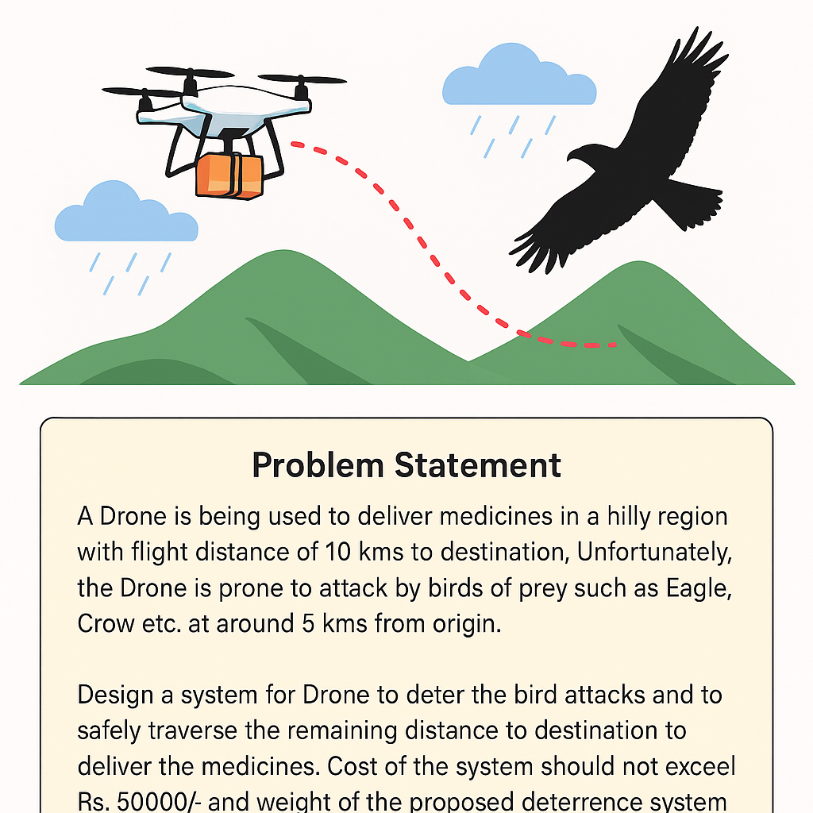
Problem Statement:
A Drone is being used to deliver medicines in a hilly region with flight distance of 10 kms to destination. Unfortunately, the Drone is prone to attack by birds of prey such as Eagle, Crow etc. at around 5 kms from origin.
Design a system for Drone to deter the bird attacks and to safely traverse the remaining distance to destination to deliver the medicines. Cost of the system should not exceed Rs. 50000/- and weight of the proposed deterrence system should not exceed 1.5 kg.
Note: The hilly area is prone to drizzles and wind gust.
© 2025 Collins Aerospace. | Collins Aerospace Proprietary. | This document does not include any export controlled technical data.

Slide 3
Expanded Problem Context – Engineering Constraints & Hidden Challenges
Engineering Design Constraints:
Attack Unpredictability: Birds typically attack around the 5 km mark but can strike at any point mid-flight.
Environmental Stress: The drone must navigate hilly terrain with frequent drizzle, fog, and sudden wind gusts.
Budget Cap: The complete deterrent system must cost ≤ ₹50,000.
Weight Limit: Total added weight (deterrent modules) must not exceed 1.5 kg.
Mission Critical: The drone must deliver medicines reliably — system failure is unacceptable.
© 2025 Collins Aerospace. | Collins Aerospace Proprietary. | This document does not include any export controlled technical data.

Slide 4
Hidden Challenges (Real-World Complexities):
Smart Adversary: Birds are intelligent, adaptive, and capable of “mobbing behaviour” — they can even attack predator-shaped objects.
Day & Night Readiness: The system must work under sunlight, fog, low light, and darkness.
Habituation Effect: Repetitive sounds/lights lose effectiveness quickly. The deterrent must be dynamic, multi-modal, and unpredictable.
Implication: This isn’t just a control system problem — it’s a multi-disciplinary challenge involving sensor fusion, embedded systems, animal behaviour, and fail-safe engineering.
© 2025 Collins Aerospace. | Collins Aerospace Proprietary. | This document does not include any export controlled technical data.

Slide 5
MOTIVATION
Nature is not the enemy — birds are intelligent co-inhabitants, not obstacles.
Our aim is not to harm but to co-exist and protect.
Existing deterrents (sound, lights, predator shapes) are often predictable and ineffective over time.
Our insight is to design a multi-layered, biologically inspired system that is ✔ Adaptive ✔ Non-lethal ✔ Technically sound ✔ Environment-aware ✔ Ready for real deployment in India’s remote terrain
© 2025 Collins Aerospace. | Collins Aerospace Proprietary. | This document does not include any export controlled technical data.

Slide 6
Dynamic Path Distortion via IMU & Magnetometer – Behavioral Disruption Layer
🔹 Strategic Objective:
Introduces slight, random wobbles into the drone’s flight path to mimic unstable or injured birds — a natural deterrent against raptors that prefer stable targets.
🔹 Flight Variation Logic:
IMU senses roll, pitch, yaw of the drone in real-time.
Magnetometer provides heading and orientation reference.
GPS gives distance context, but activation is not fixed — logic is adaptive and always-on.
A microcontroller injects micro-oscillations into the drone’s PWM signals, creating subtle flight unpredictability.
Works in both day and night, any distance, and any weather without relying on vision or sound.
🔹 Bird’s intuition:
Predatory birds instinctively avoid unstable or erratic flyers. This non-lethal behavioral trick uses bird psychology rather than aggression.

Slide 7
RF Doppler Wing Detection for Early Bird Sensing
🔹 Biological Signal Sensed:
Detects flying birds early by analyzing Doppler shifts caused by their wing flapping — enabling timely activation of deterrent responses, even in foggy or low-light conditions.
🔹 RF Doppler Processing Pipeline:
A low-power Doppler radar module (e.g., HB100 or Acconeer A111) emits or listens to ambient RF signals.
The bird’s wing movements introduce periodic frequency shifts (Doppler effect).
A microcontroller or edge processor runs FFT + pattern filtering to detect flapping motion.
Activation logic is always-on, and does not rely on visual or thermal cues — ideal for poor visibility or night conditions.
🔹 Proactive Activation:
Wing motion is a universal signature — can be detected before the bird is visible, giving the drone enough time to activate defense systems. This gives your drone a reaction window of 3–5 seconds, even during fog, drizzle, or night flights.
© 2025 Collins Aerospace. | Collins Aerospace Proprietary. | This document does not include any export controlled technical data.

Slide 8
Polarized Flicker Panel (Visual Confusion System)
🔹 Daylight Disruption Strategy:
Disrupts bird vision by randomly altering the drone’s polarized light reflection, making it appear shimmering, invisible, or distorted — confusing targeting instincts.
🔹 Optical Physics Behind It:
Birds rely heavily on polarized reflections to locate prey mid-air.
Thin-film polarizing sheet or liquid crystal layer is mounted on drone’s top.
A small current passed via MOSFET driver changes the light reflection pattern.
Activated randomly or during sensing events — works passively most of the time.
🔹 Works Best in Sunlight Conditions:
Creates a visual flicker or camouflage, especially effective against raptors during the day. Birds may lose visual lock or become hesitant to strike.
© 2025 Collins Aerospace. | Collins Aerospace Proprietary. | This document does not include any export controlled technical data.

Slide 9
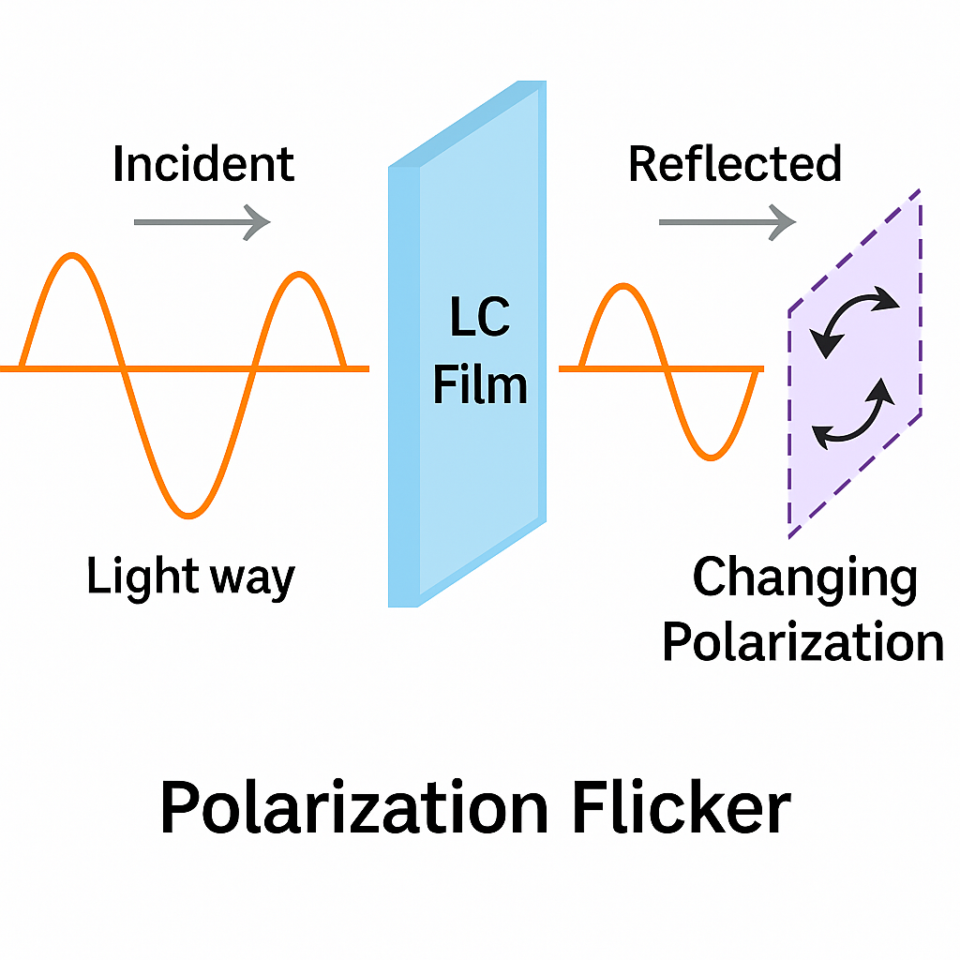
© 2025 Collins Aerospace. | Collins Aerospace Proprietary. | This document does not include any export controlled technical data.

Slide 10
IR Beacon Pulse for Nocturnal Thermal Confusion
🔹 Night-Time & Fog Strategy:
Emits pulsed infrared (IR) light to confuse birds that rely on heat or low-light vision, like owls and kites — an invisible, stealthy defense for night and fog conditions.
🔹 Pulse Timing Control Logic:
High-power IR LEDs (850–950 nm) emit invisible pulses during low-light conditions.
These pulses simulate moving heat signatures, distracting birds that lock onto prey using thermal cues.
Controlled by ambient light sensors (LDR/photodiode) + microcontroller logic.
Activated only at dusk/night or in foggy weather — otherwise off to save power.
🔹 Bio-inspired strategy:
Birds like owls use heat vision in dark environments. A moving, flashing IR source can cause confusion, hesitation, or loss of tracking.
© 2025 Collins Aerospace. | Collins Aerospace Proprietary. | This document does not include any export controlled technical data.

Slide 11
Plasma Arc Flicker – High-Impact Visual Startle System
🔹 Last-Resort Startle Mechanism:
Emits brief, high-voltage arc flashes (like micro-lightning) to startle and repel birds using sudden chaotic light. Especially effective during dusk, night, or fog when other visual signals fail.
🔹 Triggered Only on Critical Proximity:
A flyback transformer or boost converter generates ~1–5kV across a controlled spark gap (using carbon rods or plug).
Triggered via proximity sensor or adaptive threat logic from the central MCU.
Output: short, irregular plasma bursts — visually chaotic, loud and bright, like natural electric discharge.
Enclosed in transparent acrylic casing for weatherproofing and safety.
🔹 Nature inspired stimulus:
Unpredictable light + arc sound is a natural startle stimulus. Birds, especially raptors, are highly sensitive to such chaotic cues and quickly retreat.
© 2025 Collins Aerospace. | Collins Aerospace Proprietary. | This document does not include any export controlled technical data.

Slide 12
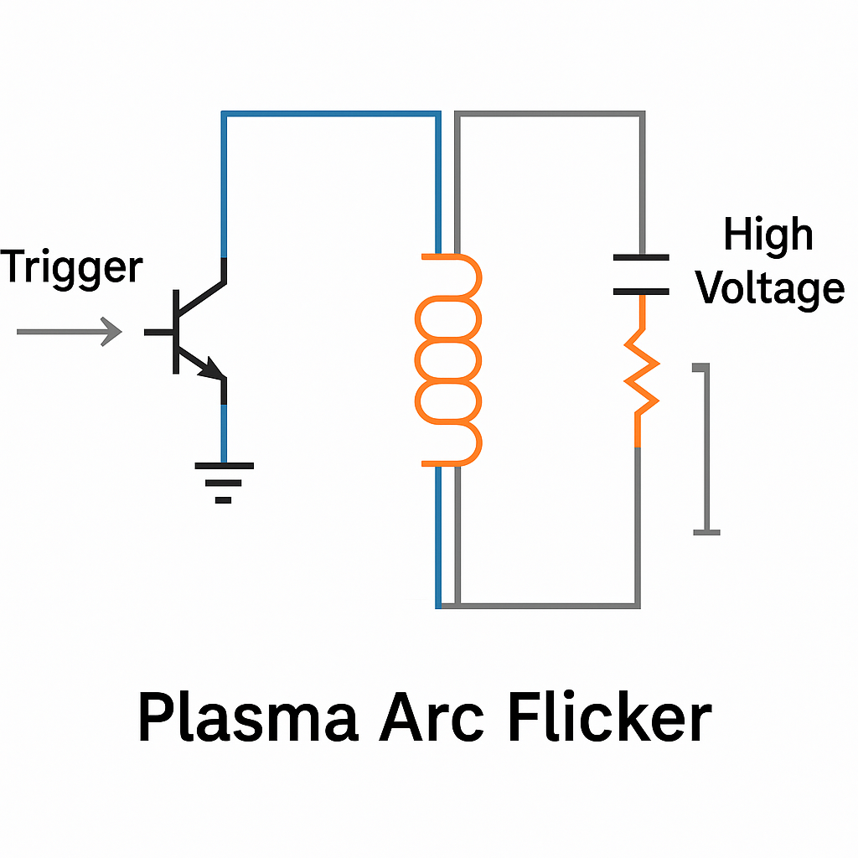
© 2025 Collins Aerospace. | Collins Aerospace Proprietary. | This document does not include any export controlled technical data.

Slide 13
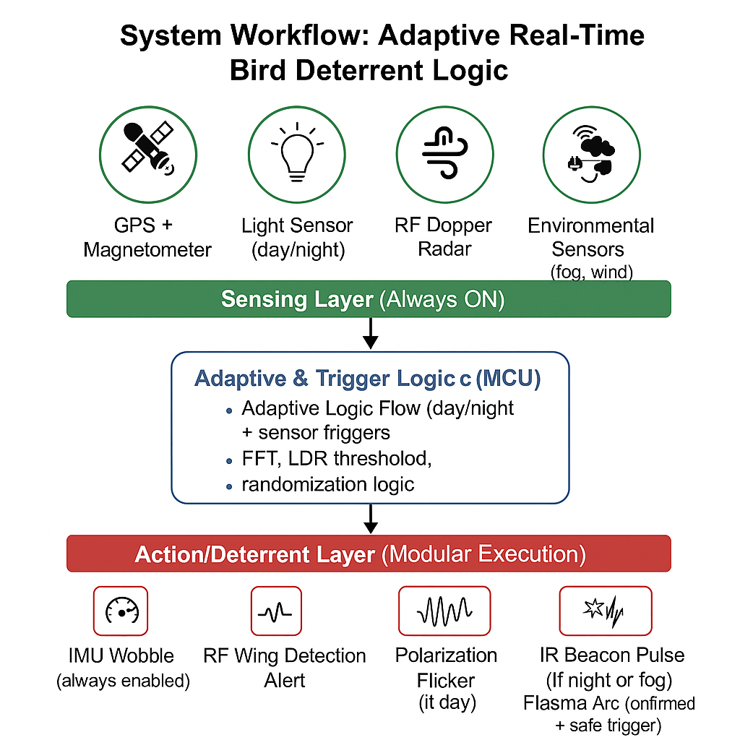
© 2025 Collins Aerospace. | Collins Aerospace Proprietary. | This document does not include any export controlled technical data.

Slide 14
Novelty vs Existing Solutions Comparison
Feature | Existing Bird Control (Airports, Farms) | Our System
Passive Flight Path Distortion | ❌ Not used | ✅ IMU + Magnetometer
RF Wing Detection (Doppler) | ⚠️ Limited use (e.g., airports) | ✅ Drone-mounted, lightweight
Polarized Light Flicker | ❌ Not used | ✅ New in UAV context
IR Beacon Pulse | ⚠️ Rare (military use) | ✅ Embedded in micro-drone
Plasma Arc Flicker | ❌ Not used | ✅ High-impact flicker innovation
Modular & Adaptive Use | ❌ One-size-fits-all | ✅ Smart triggering by light/proximity
Total Cost & Weight | ₹50,000+ often | ✅ < ₹5,000, < 400g
© 2025 Collins Aerospace. | Collins Aerospace Proprietary. | This document does not include any export controlled technical data.

Slide 15
Module-wise Pros & Cons
Module | Pros | Cons
1. Path Distortion (IMU + Magnetometer) | Light, low cost Inspired by bird evasive motion Easy to simulate | Requires calibration Might affect drone stability if overused
2. RF Doppler Detection | Detects birds before visual range Works in fog/night No light or sound emitted | Needs FFT or analog filtering Slightly higher power use
3. Polarization Flicker Panel | Silent, light-based Daylight use Non-invasive to humans | Moderate novelty Less effective at night
4. IR Beacon Pulse | Stealthy (invisible to humans) Great for night & fog Energy efficient (pulsed) | Ineffective in bright sunlight Requires line-of-sight trigger logic
5. Plasma Arc Flicker | High deterrence value Sound + visual arc = strong startle Novel solution | Needs safety casing Moderate power draw Slightly heavy
© 2025 Collins Aerospace. | Collins Aerospace Proprietary. | This document does not include any export controlled technical data.

Slide 16
Comparison with Existing Drone-Based Bird Deterrent Systems
Existing System / Study | Features Used | Limitations | What We Add / Improve
ISRO ReHIT UAV 2021 (hypothetical) | GPS-guided drone, no deterrent | No bird detection or deterrence | Adds 5-layer deterrent logic with adaptive modules
“Drone with IR Blinker” – Univ. of Tokyo Study | IR LED blinking at 10Hz | Only works in night/fog, not adaptable | Adds decision logic + 4 more sensory layers
BirdStrikeRadar Inc. System | Ground RF Doppler on runway | Fixed, ground-based only | We miniaturized RF Doppler on drone itself
Predator Decoy Drone (Bioinspired Shape) | Owl-shaped drone body | Static behavior, easy to adapt to | Ours has visual + movement + signal deterrents
Military Falcon Eye System | Laser dazzler + sound pulses | Expensive, non-civil use, high power | We use low-power plasma arc with randomization
© 2025 Collins Aerospace. | Collins Aerospace Proprietary. | This document does not include any export controlled technical data.

Slide 17
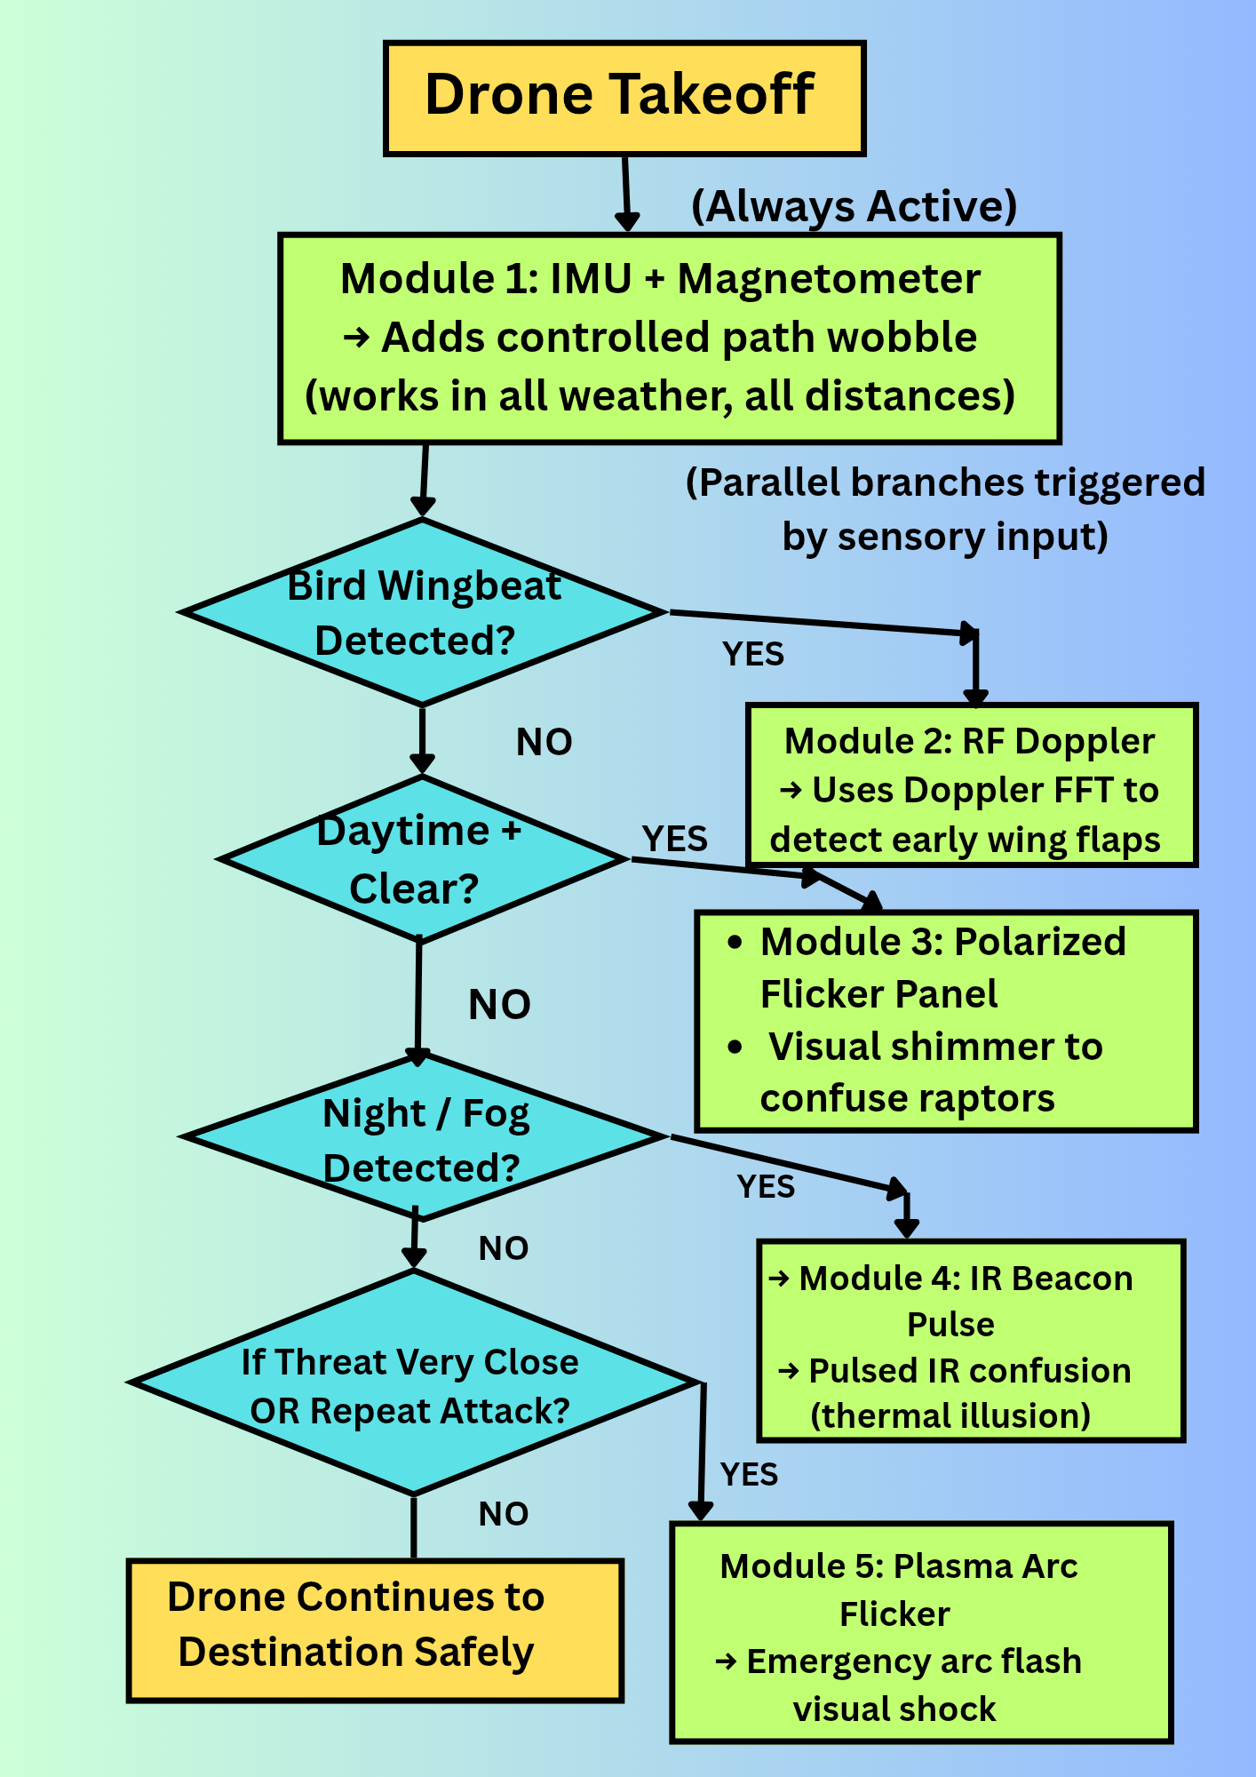
WORKFLOW
© 2025 Collins Aerospace. | Collins Aerospace Proprietary. | This document does not include any export controlled technical data.

Slide 18
Conclusion
We proposed a low-cost, modular, multi-modal drone deterrence system.
Each module is biologically inspired and environment-adaptive.
Logic-driven activation ensures power efficiency & targeted response.
Simulations, diagrams, and component sheets demonstrate feasibility.
Acknowledgement:
No system is perfect — each module has pros and cons.
Effectiveness depends on bird behavior, environment, and timing.
Adaptability, not over-engineering, is our key design principle.
Takeaway:
An intelligent, scalable system — built not to eliminate the threat, but to outsmart it.
© 2025 Collins Aerospace. | Collins Aerospace Proprietary. | This document does not include any export controlled technical data.

Slide 19
THANK YOU
“Nature always finds a way — so must innovation.” — AeroHack 2025 Vision
© 2025 Collins Aerospace. | Collins Aerospace Proprietary. | This document does not include any export controlled technical data.

